Slide 1

TRƯỜNG CAO ĐẲNG LÝ TỰ TRỌNG TP.HCM
BẬC ĐÀO TẠO: CAO ĐẲNG CHUYÊN NGHIỆP
GIẢNG VIÊN: NGUYỄN THỊ THU TÂM

Slide 2
UNIT 3
BÀI : 3B READING

Slide 3
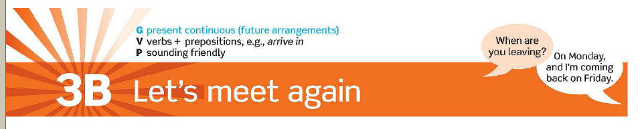


Slide 4


Slide 5
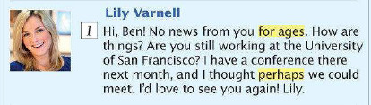
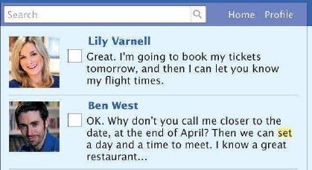
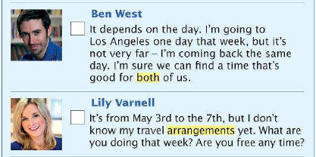
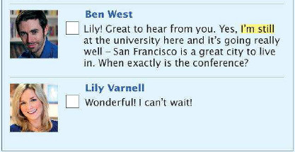

Slide 6

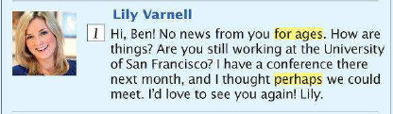

Slide 7
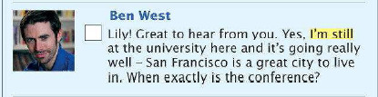
2

Slide 8

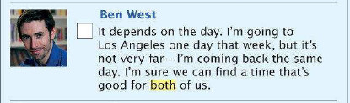
3
4

Slide 9

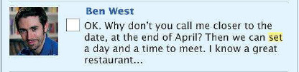

5
6
7

Slide 10
Vocabulary
1. Set /set/ (v)
=
decide something
We can set a day and time to meet.

Slide 11
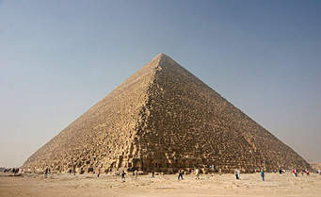

Slide 12
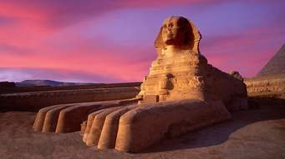

Slide 13
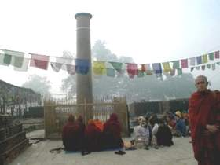

Slide 14
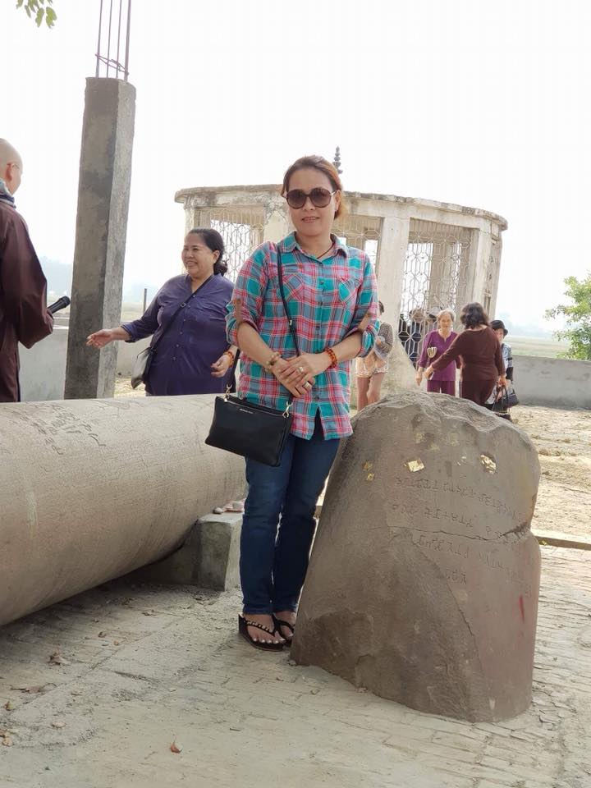

Slide 15
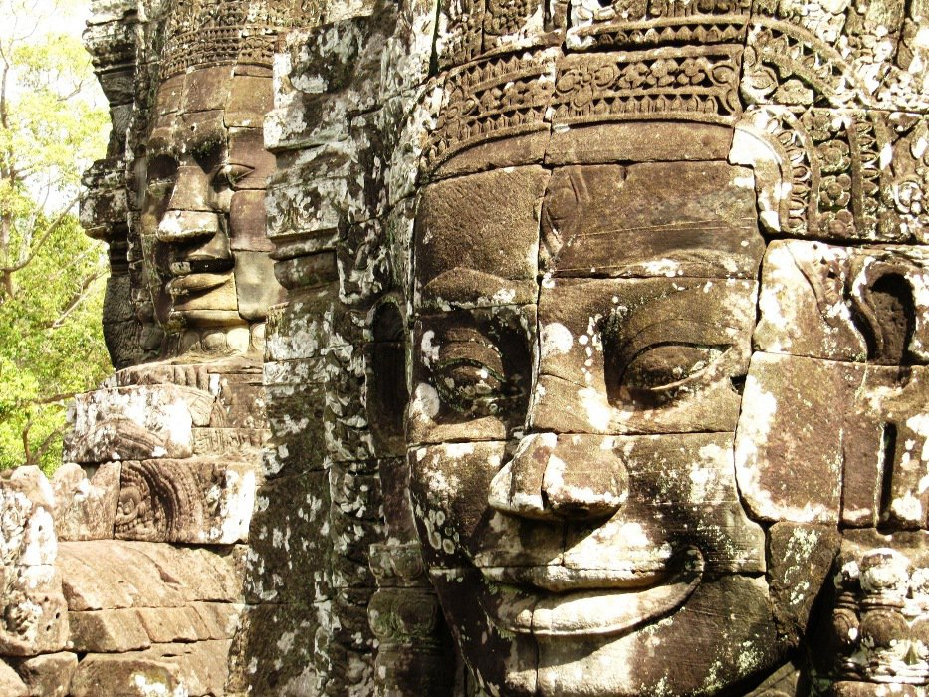
2. For ages : a very long time
We’ve been waiting (for) ages for a bus.

Slide 16
Vocabulary
3. Perhaps /pər’hæps/ (adv)
=
Maybe
Ex: Perhaps it will rain.

Slide 17
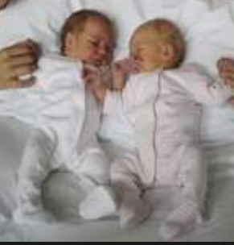

Slide 18
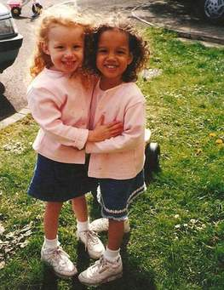

Slide 19
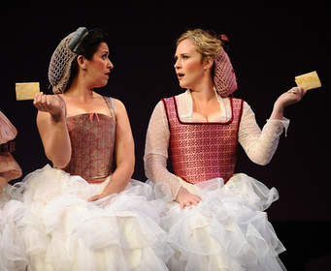

Slide 20
Vocabulary
4. Both: used with plural nouns to mean “the two” or “the one as well as the other”
Ex : Both women were French.

Slide 21
Vocabulary
5. Arrangement / ə’reɪndʒmənt/ (n
= plan, preparation
Have you made any arrangements for a meeting with him?

Slide 22
Vocabulary
6. still (adv) : continuing until a particular point in time and not finishing
Ex : I wrote to them last month and I'm still waiting for a reply.
Ex : Do you still live at the same address?

Slide 23

1. Why does Lily get in touch with Ben ?
Because she has a conference at the University of San Francisco.

Slide 24
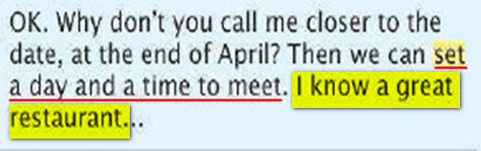
2. What are they planning to do ?
They are planning to meet for dinner in a restaurant that Ben knows.

Slide 25


for ages
2. arrangement
definite /’definit/ (a)
= clear
Ex : I’ll give you a definite answer later.

Slide 26


I’m still
Perhaps
Both
set
decide : to settle or make the result (of something) etc certain
Ex: The last goal decided the match.

